Slide 1
Wentzville School District
Strengths-Based
Philosophy & Practice
Bob Bertolino, Ph.D. Professor, Maryville University-St. Louis
Sr. Clinical Advisor, Youth In Need, Inc.
Sr. Associate, International Center for Clinical Excellence

Slide 2
Tidbits
For copyright reasons and confidentiality some of PowerPoint slides may be absent from your handouts.
To download a PDF of this presentation, please go to: www.bobbertolino.com.
Please share the ideas from this presentation. You have permission to reproduce the handouts. I only ask that you maintain the integrity of the content.
Contact: bertolinob@cs.com; 314.852.7274.
bobbertolino.com

Slide 5
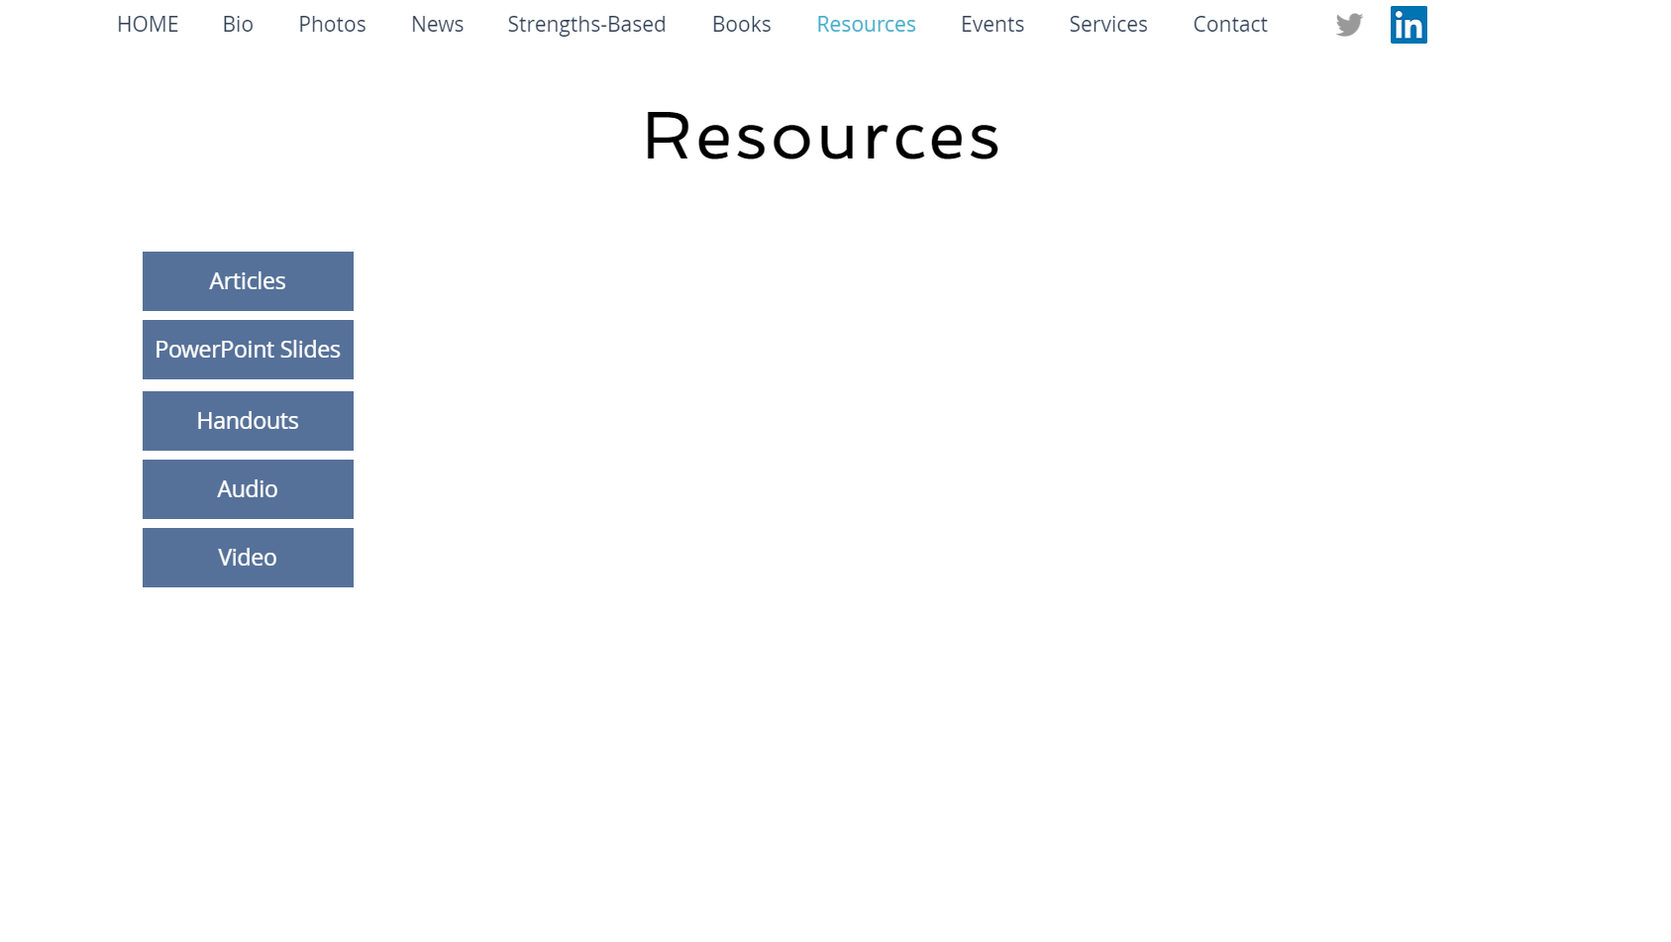
Slides for today’s session

Slide 6
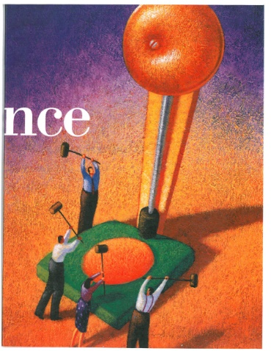
An Agency’s Journey Toward Excellence
Organizations must pave their own paths. One that involves developing a culture that emphasizes but is not limited to diversity and inclusion, strengths, and collaboration.

Slide 7
From the Inside Out
Are you in this field because of a passion, a wound, or both?
Four life energies, two passions and two wounds.
Two Passions: Blissed and Blessed
Two wounds: Dissed and Pissed.
Each life energy creates opportunities to either follow and further develop a source of positive energy further or to use a source of a negative energy or wound to pursue something meaningful.

Slide 8
Blissed
Professor of Literature and mythologist Joseph Campbell said, “Follow your bliss and the universe will open doors for you where there were only walls.”
Campbell elaborated that if a person’s follows his or her bliss, “You put yourself on a kind of track that has been there all the while, waiting for you, and the life that you ought to be living is the one you are living. Wherever you are—if you are following your bliss, you are enjoying that refreshment, that life within you, all the time.
Campbell encourages each person to let his or her “life speak.”
As a way to increase meaning, we can follow or passions and develop them in ways that contribute to a life that is more authentic and fully-lived.

Slide 9
Blissed (cont.)
The late entrepreneur and co-founder of Apple, Inc., Steve Jobs once described the importance of following your bliss.” Jobs remarked:
“You’ve got to find what you love. And that is true for your work as it is for your lovers. Your work is going to fill a large part of your life, and the only way to be satisfied is to do what you believe is great work. And the only way to do great work is to love what you do. If you haven’t found it yet, keep looking. Don’t settle. As with all matters of the heart, you’ll know it when you find it.”
Your time is limited, so don’t waste it living someone’s life. Don’t be trapped by dogma–which is living with the results of other people’s thinking. Don’t let the noise of others’ opinions drown out your own inner voice. And most important, have the courage to follow your heart and intuition. They somehow already know what you truly want to become. Everything else is secondary.”

Slide 10
Blessed
Some people feel as if they have a mission to fulfill or perhaps they were born to do something in the service of others.
Often referred to as “a calling,” this life energy can be born out of religious or spiritual beliefs or emerge from life experience and a deeper understanding of one’s self. For example, a person may have survived a life-threatening event and as a result made a decision to serve others in a way he or she had not previously done.
Still others have been told that they have a “gift” and are encouraged to share those gifts with the larger world.
In such cases, meaning can be found through pursuit of one’s blessings.

Slide 11
Dissed (Wounded)
Some life energies come from suffering.
Dissed, which is short for disrespected, is an example.
After Joseph Campbell’s dictum, “Follow your bliss,” became well-known, he grew concerned that people had misunderstood it to mean he was encouraging hedonism (i.e., self-indulgence).
Campbell reportedly responded, "I should have said, 'Follow your blisters.’” His point was that bliss is a path that can emerge from either a passion or a wound that the person transforms into life meaning.
People can experience pain or hurt, depersonalization, marginalization, being put down, and the like.
As a life energy, In time we may transform our liabilities into gifts.
The key, then, is to transform the negative energy of suffering and hurt into positive energy.

Slide 12
Dissed (Wounded) (cont.)
Here are two examples of turning wounds into positive energy:
Novelist Ann Rice lost her daughter to leukemia at the age of 5. Rice would go on to write, “Interview with the Vampire,” a novel that featured a 5-year-old who could never die. Rice reflected, “I didn't know it at the time but it was all about my daughter, the loss of her and the need to go on living when faith is shattered. But the lights do come back on, no matter how dark it seems, and I'm sensitive now, more than ever, to the beauty of the world—and more resigned to living with cosmic uncertainty.”
Throughout his life, Bono, singer for the band U2, has written about his wounds.
At the age of 14 his mother passed away. Over the course of 40 years, he has written songs to help transform his wound (“I Will Follow,” “Out of Control,” “Tomorrow,” “Lemon,” “Mofo,” “Iris”).
Bono also wrote songs to reconcile his relationship with his father (“Sometimes You Can’t Make It on Your Own,” “One Step Closer,” “Kite”).
A third example is, “Mothers of the Disappeared,” in which Bono wrote about mothers whose children had “forcibly disappeared” in Nicaragua and El Salvador.

Slide 13
Pissed (Righteous Indignation)
There are times when people are not only wounded, they are angry or “pissed.”
Because anger can scare people, there are often efforts to dampen or get rid of it. The expression of anger in destructive ways can have steep consequences.
But anger can be quite useful and contribute to a positive life direction and contribution.
Similar to “Dissed,” the key is to transform the negative energy of anger and hurts into positive energy.
Reverend Dr. Martin Luther King stated, “Darkness cannot drive out darkness; only light can do that. Hate cannot drive out hate; only love can do that.”

Slide 14
Personal Philosophy: It Begins with You
What are your core beliefs, ideas, or assumptions about working in in the WSD?
How have you come to believe what you believe about current and/or future teachers and students and WSD?
What has most significantly influenced your beliefs, ideas, and assumptions as they relate to your work with teachers and students?
To the best of your knowledge, how might your beliefs, ideas, and assumptions affect your work at school? With colleagues/peers? With the community at-large?

Slide 15
Personal Philosophy: It Begins with You (cont.)
How do you believe that change occurs? What does change involve?
Do you believe that some degree of change is possible with teachers and students? (If you answered “yes” then end here.) (If you answered “no,” proceed to the next question.)
How will you work with teachers and students if you believe they cannot (or do not want to or are resistant to) change?
If you do not believe that each person with who you work can experience some degree of change, what keeps you in this field?

Slide 17
What Does is Mean to be Strengths-Based?

Slide 18
A Shift From Pathology to Strengths
“What we have learned over 50 years is that the disease model does not move us closer to the prevention of these serious problems. Indeed the major strides in prevention have largely come from a perspective focused on systematically building competency, not correcting weakness. Prevention researchers have discovered that there are human strengths that act as buffers against mental illness: courage, future-mindedness, optimism, interpersonal skill, faith, work ethic, hope, honesty, perseverance, the capacity for flow and insight, to name several. Much of the task of prevention in this new century will be to create a science of human strength whose mission will be to understand and learn how to foster these virtues in young people… We need to ask practitioners to recognize that much of the best work they already do in the consulting room is to amplify strengths rather than repair the weaknesses of their clients.” (p. 6-7)
Seligman, M. E. P., & Csikszentmihalyi, M. (2000). Positive psychology: An introduction. American Psychologist, 55(1),
5–14.

Slide 19
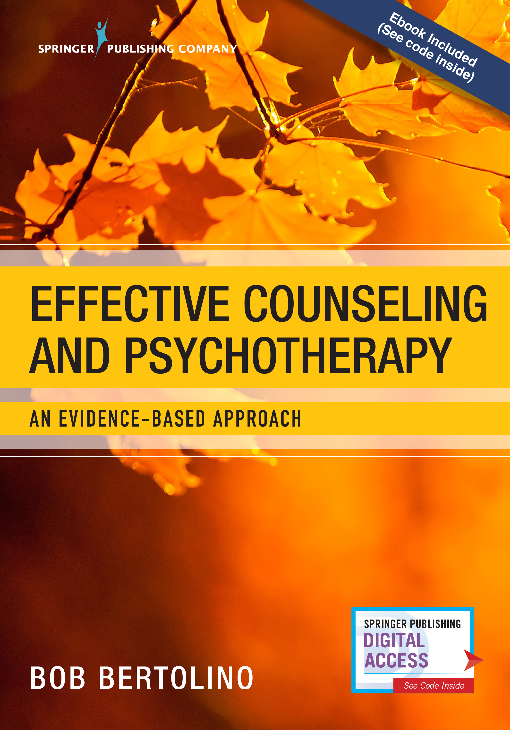
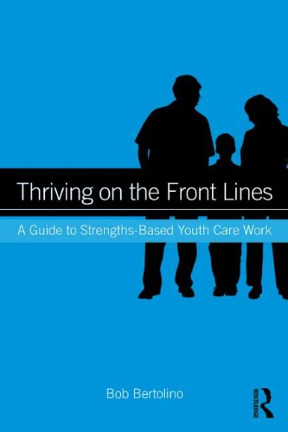
What is Strengths-Based?
A strengths-based perspective emphasizes the abilities and resources people have within themselves and their support systems to more effectively cope with life challenges. When combined with new experiences, understandings and skills, these abilities and resources contribute to improved well-being and outcome, which is comprised of three areas of functioning: individual, interpersonal relationships, and social role. Strengths-based practitioners value relationships and convey this through respectful, culturally-sensitive, collaborative, practices that support, encourage and empower. Routine outcome monitoring (ROM) is used to create and maintain a culture of feedback—a responsive, consumer-driven climate to ensure the greatest benefit of services.
Bertolino, B. (2018). Effective counseling and psychotherapy: An evidence-based approach. New York:
Springer
Bertolino, B. (2014). Thriving on the front lines: Strengths-based youth care work. New York: Routledge.

Slide 20
Strengths-Based Defined
A strengths-based perspective emphasizes the abilities and resources people have within themselves and their support systems to more effectively cope with life challenges. When combined with new experiences, understandings and skills, these abilities and resources contribute to improved well-being and outcome, which is comprised of three areas of functioning: individual, interpersonal relationships, and social role. Strengths-based practitioners value relationships and convey this through respectful, culturally-sensitive, collaborative, practices that support, encourage and empower. Routine outcome monitoring (ROM) is used to create and maintain a culture of feedback—a responsive, consumer-driven climate to ensure the greatest benefit of services.
Bertolino, B. (2018). Effective counseling and psychotherapy: An evidence-based approach. New York:
Springer
Bertolino, B. (2014). Thriving on the front lines: Strengths-based youth care work. New York: Routledge.

Slide 21
The Evolution of Psychotherapy (1985) The Convocation
“We are here to speak to commonalities that underlie successful clinical work…. In the evolution of the infant discipline of psychotherapy, the first 100 years have been divergent. It has been a period of growth, consisting of flowers and weeds. Especially in the last 40 years, there has been a proliferation of discrete schools. Perhaps we can begin this second century in a way that is more convergent (Zeig, 1987, p. xxvii).
Zeig, J. K. (1987). Introduction. In J. K. Zeig (Ed.), The evolution of psychotherapy (pp. xv-xxviii). New
York: Brunner/Mazel.
Notes:
21

Slide 22
The Evolution of Psychotherapy (1985) The Experience
Joseph Wolpe referred to the conference as a “babble of conflicting voices” (Leo, 1985, p. 59).
In a review by Time magazine, one attendee commented, ''All the experts are here, and none of them agree'' (p. 59).
In attempting to present their own position in its clearest, least complicated, and most elementary form for the large audience, the speakers created and subsequently demolished caricatures of opposing viewpoints…. (Shapiro, 1987, p. 66)
Leo, J. (1985). A therapist in every corner: Harmony was the goal, but participants seemed out of tune. Time, 126(25), 59.
Shapiro, J. L. (1987). Message from the master on breaking old ground. The evolution of psychotherapy conference.
Psychotherapy in Private Practice, 5(3), 65-72.
Notes:
22

Slide 23
The Evolution of Psychotherapy (1985) The Conclusion
"Here were the reigning experts on psychotherapy and I could see no way they could agree on defining the territory. Can anyone dispute, then, that the field is in disarray?" (Zeig, 1987, pp. xviii-xix).
Zeig, J. K. (1987). Introduction. In J. K. Zeig (Ed.), The evolution of psychotherapy (pp. xv-xxviii). New
York: Brunner/Mazel.
Notes:
23

Slide 24
Evidence-Based Practice (EBP)*
It is important to have evidence that supports programs and practices.
Evidence-based practice includes three components, each of which is reliant on the others:
Best available research
Provider expertise
Consideration of client characteristics, culture and preferences.

Slide 25
Best Available Research The Variance in Psychotherapy Outcome
Client/Extratherapeutic Factors = 80-87%
Treatment Effects = 13-20%
Therapist Effects = 4-9%
The Alliance = 5-8%
Expectancy, Placebo, and Allegiance = 4%
Model/Technique = 1%
Bertolino, B., Bargmann, S., & Miller, S. D. (2013). Manual 1: What works in therapy: A primer. The ICCE manuals of feedback informed
treatment. Chicago, IL: International Center for .Clinical Excellence.
Wampold, B. E., & Brown, G. S. (2005). Estimating variability in outcomes attributable to therapists: A naturalistic study of outcomes in
managed care. Journal of Consulting and Clinical Psychology, 73(5), 914-923.

Slide 26
Strengths-Based Principles
Expectancy and hope are catalysts of change.
Clients are the most significant contributors to outcome.
The therapeutic relationship makes substantial and consistent contributions to outcome.
Culture influences and shapes all aspects of human life.
Effective services promote growth, development, well-being, and functioning.
*Refer to the handouts in your packet.

Slide 27
Language: The Costs of Negativity
Research shows that extensive discussions of problems and encouragement of ‘‘problem talk,’’ rehashing the details of problems, speculating about problems, and dwelling on negative affect in particular, leads to a signiﬁcant increase in the stress hormone cortisol, which predicts increased depression and anxiety over time. (Byrd-Craven, Geary, Rose, & Ponzi, 2008)
People who are in a more positive mood are better liked by others and more open to new ideas and experiences. (Fredrickson, 1998)
Byrd-Craven, J., Geary, D. C., Rose, A. J., & Ponzi, D. (2008). Co-ruminating increase stress hormone levels in women. Hormones
and Behavior, 53, 489–492.
Fredrickson, B. (1998). What good are positive emotions? Review of General Psychology, 2, 300-319.

Slide 28
Language: The Costs of Negativity (cont.)
Recent studies by the University of Pennsylvania demonstrated a link between language used on social media (i.e., Facebook, Twitter, etc.) and heart disease—expressions of negative emotions such as anger, stress and fatigue in tweets were associated with higher heart disease risk. (Eichstaedt, et al., 2015a, 2015b)
The same researchers also found that positive emotions like excitement and optimism were associated with lower risk of heart disease. (Eichstaedt, et al., 2015a, 2015b)
Ireland, Schwartz, Chen, Ungar, and Albarracin (2015) studied HIV prevalence and learned that sexually transmitted infection rates and references to risky behavior on Twitter were associated with higher HIV prevalence in all counties except those with high rates of future orientation.
Eichstaedt, J. C., Schwartz, H. A., Kern, M. L., Park, G., Labarthe, D. R., Merchant, R. M., Jha, S., Agrawal, M., Dziurzynski, L. A., Sap, M., Weeg,
C., Larson, E. E., Ungar, L. H., & Seligman, M. E. P. (2015a). Psychological language on Twitter predicts county-level heart disease mortality.
Psychological Science, Vol 26(2), 159-169.
Eichstaedt, J. C., Schwartz, H. A., Kern, M . L., Labarthe, D. L., Merchant, R. M.,Jha, S., Agrawal, M., Dziurzynski, L. A., Sap, M., Weeg, C., Larson,
E. E., Ungar, L. H., & Seligman, M. E. P. (2015b). Psychological language on Twitter predicts county-level heart disease mortality. Psychological
Science, 1-11.
Ireland, M. E., Schwartz, H. A., Chen, Q., Ungar, L. H., & Albarracin, D. (2015). Future-oriented tweets predict lower county-level HIV prevalence in
the United States. Health Psychology, 34, 1252-1260.

Slide 29
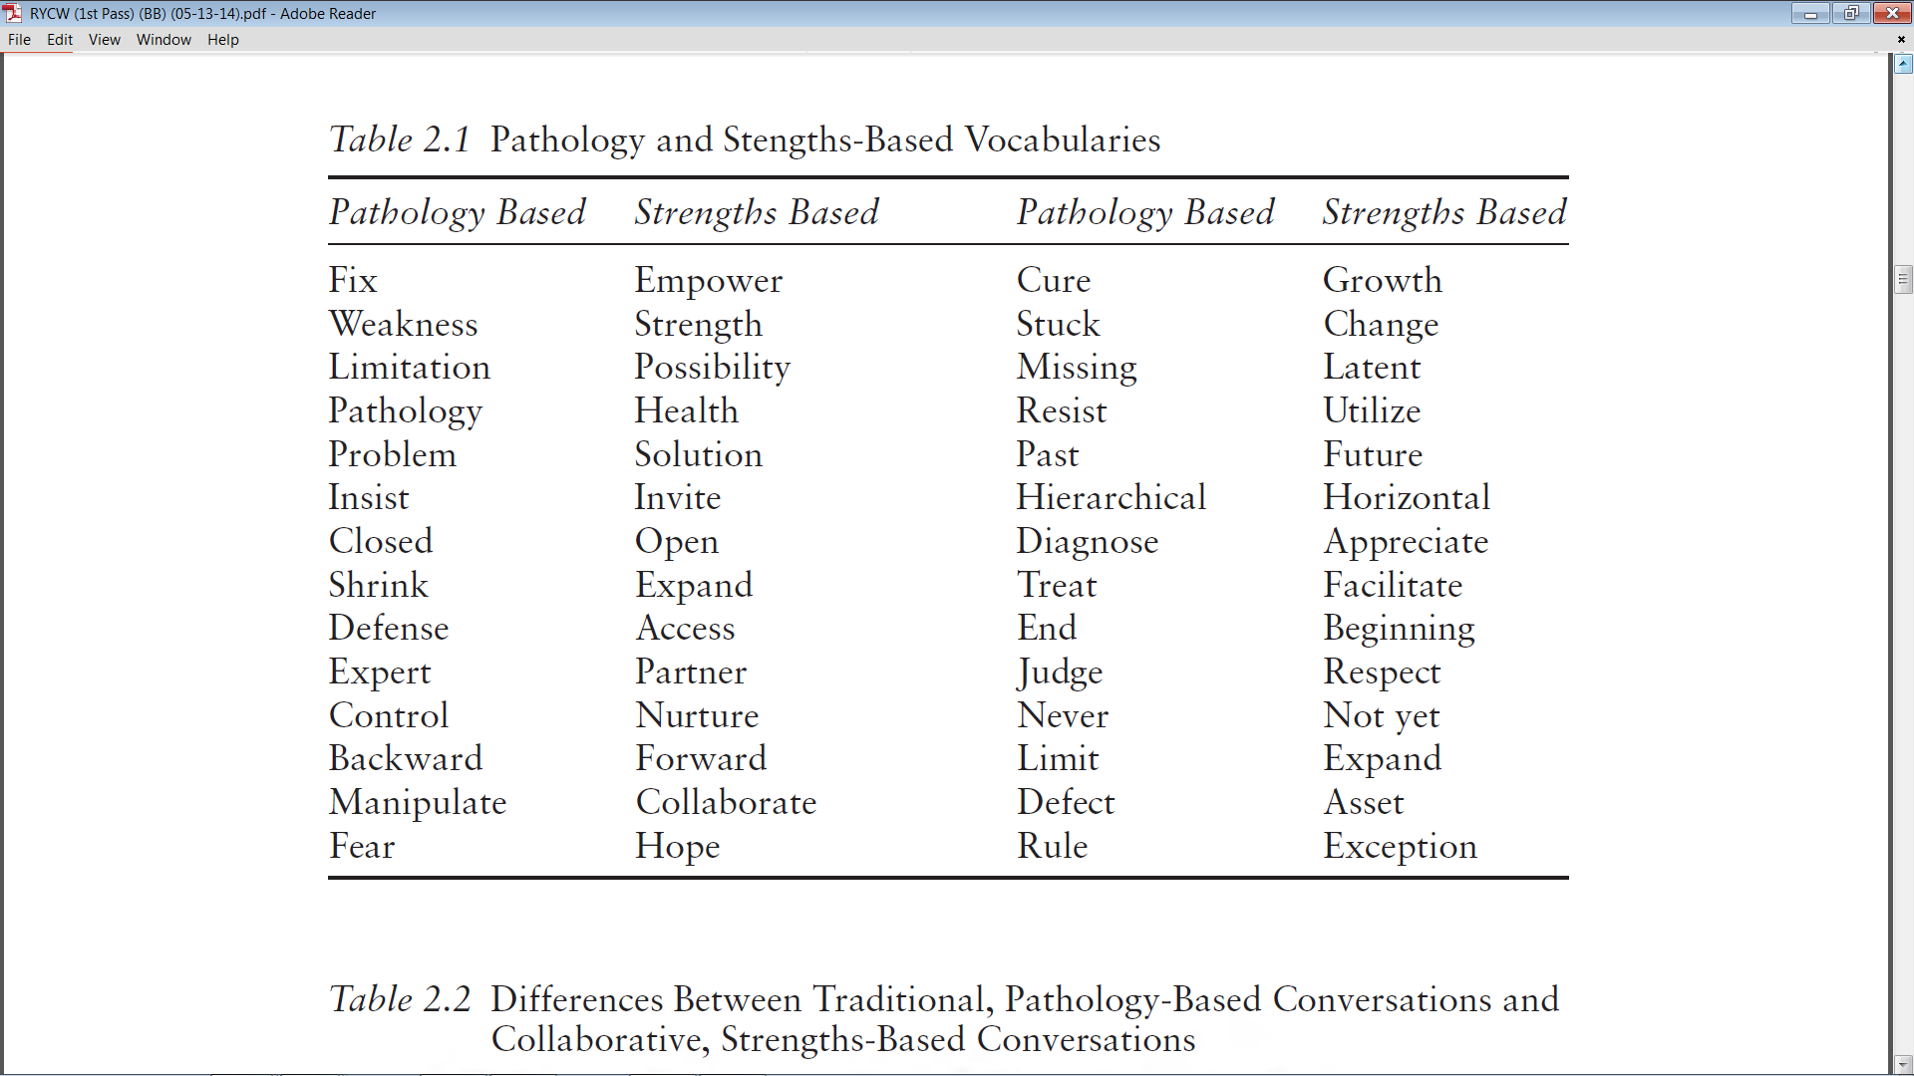
Bertolino, B. (2015). The residential youth care worker in action: A collaborative, strengths-based approach.
New York: Routledge.

Slide 30
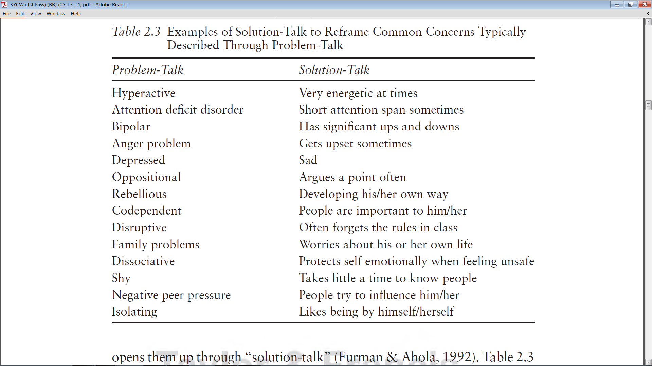
Bertolino, B. (2015). Working with children and adolescents in residential care: A strengths-based approach. New York: Routledge.

Slide 31
Say it in Another Way
“He doesn’t want to change.”
“She is manipulative.”
“He’s got an antisocial personality.”
“She’s overly sensitive.”
“He’s got an anger management problem.”
“She’s too dependent and needy.”
“He’s always inappropriate around females.”
“She’s borderline.”

